Slide 1
GENDER 101
Technical Assistance for Nutrition (TAN)
January 25, 2018
Elizabeth Dyke, PhD
e.dyke@videotron.ca

Slide 2
GENDER
  Socially constructed
  Can vary from society to society, and from time to time
  Concerned with socially acceptable norms and behaviours
http://www.who.int/gender-equity-rights/understanding/gender-definition/en/
Notes:
give me an example of a gender norm in your culture when it comes to nutrition?
Versus sex – which is biological

Slide 3
GENDER NORMS
Which of these are biology (genetic/sex) and which are social/cultural (gender)?
Girls are gentle; boys are not.
Having sex with her husband is a woman’s duty.
Women can get pregnant; men cannot.
Men are good at logical and analytical thinking.
Real men don’t cry.
Women can breastfeed babies; men cannot.
Women are creative and artistic.
Women have maternal instincts.
Men’s voices break at puberty; women’s voices don’t.
Men have a greater sex drive than women.
Women like to dress up and wear makeup.
Men should be the wage earners of a family, not women.
Women are natural caregivers and men are not.
FROM: HIV Alliance Sexual and reproductive health and rights, and HIV 101 workshop guide
Notes:
ASK: Which of these are biology (genetic/sex) and which are social/cultural (gender)?
Which statements are examples of how society expects people to be and act based on their gender rather than innate qualities?
Only “women can get pregnant and men cannot” (3), Women can breastfeed babies and men cannot” (6), and “men’s voices break at puberty and women voices don’t’ (9) are biology.
Nutrition can be influenced by a person’s gender. For example, in a marital relationship, it may be the man who has the power to decide what to eat, who eats and when.

Slide 4
CHALLENGES WITH GENDER NORMS
Can result in inequalities, if these result in:
  Different treatment of a group over another
  A group that has different opportunities than another group, or has power over another group
http://www.who.int/gender-equity-rights/understanding/gender-definition/en/
Notes:
Can you give me an example of a gender norm in your culture when it comes to nutrition?
e.g. breastfeeding, how much and what women should eat versus men etc.

Slide 5
ROLE OF GENDER IN HEALTH
Many differences in disease patterns are not explained by sex/biology.
But many health outcomes differ because of gender norms and hence can be lessened or avoided.
World Health Organization (2011). Gender mainstreaming for health managers: a practical approach. Geneva, WHO. (Participant’s Notes), p. 16

Slide 6
WHY DOES GENDER MATTER TO NUTRITION?
Factors that can impact women and children's nutrition:
  Women’s ability to influence household decisions
  Extent women are able to access/control resources for their personal health/well-being
Factors that can negatively impact women and children's nutrition:
  Heavy work burden on women
  Large age difference between the wife and her husband
  The role of the mother-in-law
  Polygamous relationships (e.g. children of the wife who is “less important” (p. 26))
  No suitable substitute caregivers in families (due to low income/parental pressure to work)
  Cultural norms (e.g. around breastfeeding), making it important to engage men and other members of the household (e.g. mother-on-laws) in education
  Gender-based violence
UNICEF and Liverpool School of Tropical Medicine (2011). Gender Influences on Child Survival, Health and Nutrition: A Narrative Review. New York, UNICEF.
Notes:
“The extent to which women are able to influence decision-making within the household influences how resources are channeled to children both in terms of nutrition and health inputs (i.e. feeding practices, prenatal and birthing care, treatment-seeking for child illness and immunisation” (p. 5)
“Women’s ability to access and control the use of resources for their own health and well-being impacts significantly on their children's survival, health and nutrition” (p. 5)
“Women’s multiple responsibilities (which often encompass domestic tasks, child care and paid labour) present a heavy burden on women which has potentially negative impacts for child health and nutrition outcomes. Men, on the other hand, are often not expected to bear responsibility for domestic tasks or child care, which restricts the care options for children whose mothers are over-loaded” (p. 6)

Slide 7
WHY DOES GENDER MATTER TO NUTRITION? (2)
Factors that can positively impact women and children's nutrition:
  Older maternal age
  Higher maternal education
  Women’s exposure over lifetime to paid employment
  Women’s ability to make decisions for domestic purchases and when to seek health care
Addressing gender can help put and end to intergenerational malnutrition
UNICEF and Liverpool School of Tropical Medicine (2011). Gender Influences on Child Survival, Health and Nutrition: A Narrative Review. New York, UNICEF.
SUN (2015). "Guidance Note - 21st SUN Movement Country Network Meeting (14-18 September 2015): Thematic Discussion - Equity and Gender.

Slide 8
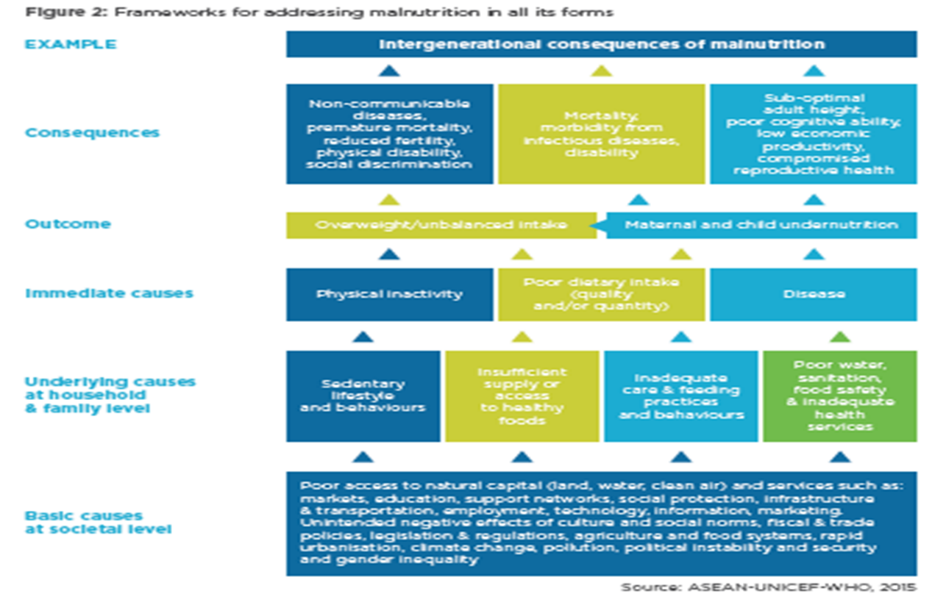

SUN (2016). "Checklist on the criteria and characteristics for ‘good’ national nutrition plan”http://docs.scalingupnutrition.org/wp-content/uploads/2016/12/Scaling-Up-Nutrition-Quality-national-plan-checklist.pdf, p. 3

Slide 9
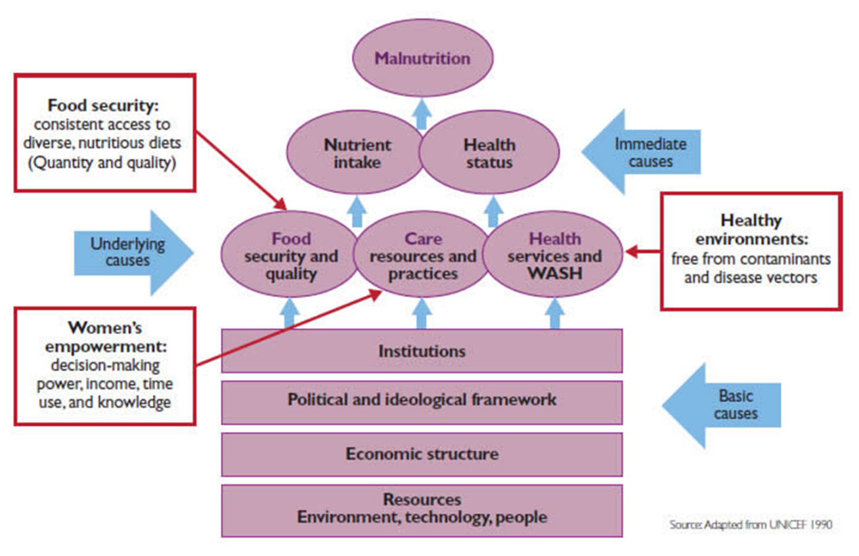
UNICEF FRAMEWORK FOR MALNUTRITION
https://www.spring-nutrition.org/publications/briefs/understanding-and-applying-primary-pathways-and-principles (Annex 2)
Notes:
“Why treat people only to send them back to the conditions that made them sick in the first place?”
― Rishi Manchanda, The Upstream Doctors

Slide 10
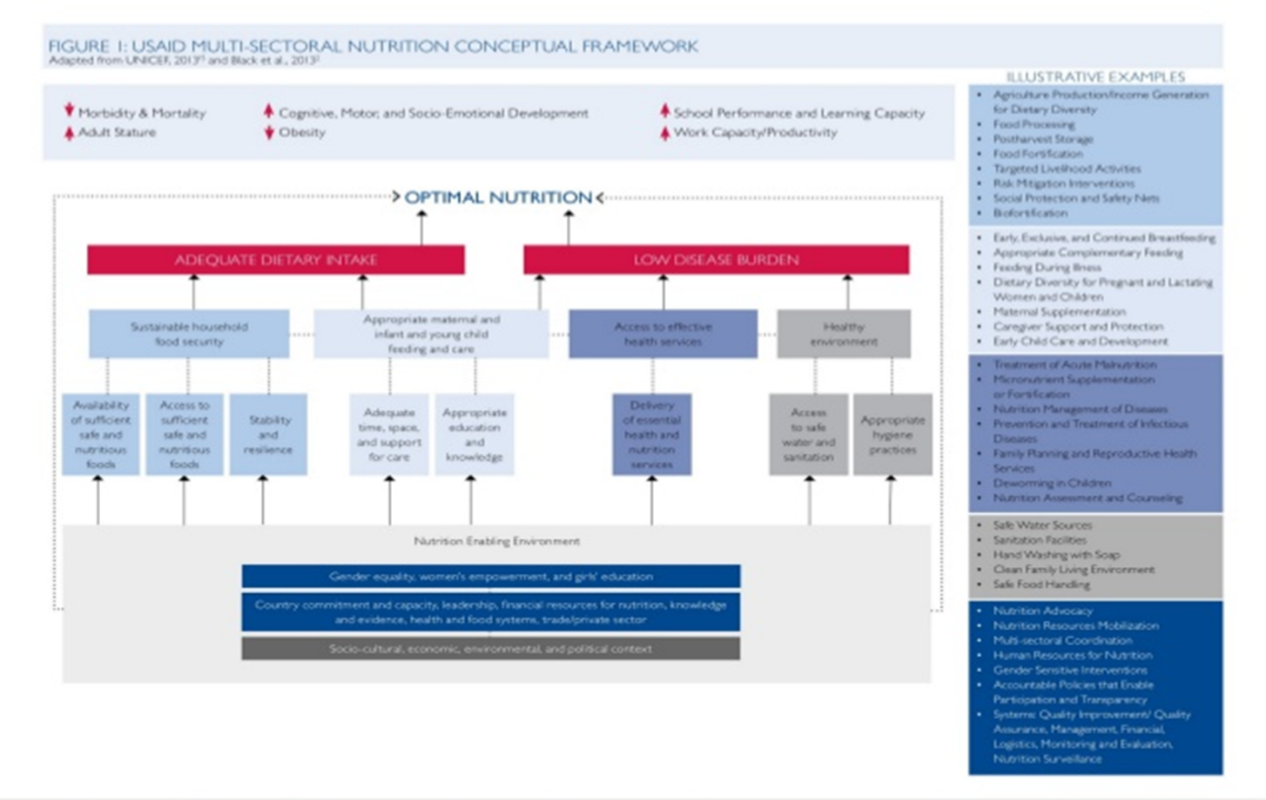
https://www.usaid.gov/sites/default/files/documents/1867/USAID_Nutrition_Strategy_5-09_508.pdf, p. 13

Slide 11
WHY DOES GENDER MATTER TO NUTRITION? (2)
“Malnutrition reflects socio-economic and gender inequalities in access to food, incomes, productive resources and other essential goods and services. Women have specific nutritional requirements that need to be acknowledged and met. In addition, gender-sensitive interventions should recognize and address women’s critical role in food production, food purchase, processing and meal preparation and in providing care and support for family members.
Empowering women and improving their access to, and control over, resources, opportunities, services and information can increase their productivity as food producers as well as incomes from other sources, resulting in better nutrition, health and education outcomes for all the family”.
http://www.fao.org/about/meetings/icn2/faq/en/
Notes:
Summarizing what was covered in frameworks
Focus needs to move beyond women’s role as having babies and breastfeeding those babies.

Slide 12
WHY DOES GENDER MATTER TO NUTRITION? (3)
“Strengthening women’s role in policy development is key for poverty alleviation and the eradication of malnutrition.
Women’s voices should be heard in decision-making from the household to the political level.”
http://www.fao.org/about/meetings/icn2/faq/en/

Slide 13
SUN MOVEMENT COMMITMENT TO GENDER
One of six priorities in SUN’s 2016-2020 Strategy:
“Equity, equality and non-discrimination for all – with women and girls at the centre”
“By 2020, all SUN countries will:
  Have equitable improvement in the nutrition status of all people, ensuring that no one is left behind
  Adopt policies that reduce nutritional inequities, especially among women and girls and eliminate discriminatory laws and practices
  Strive to involve representatives from all communities in their decision-making processes”
SUN (n.d.). "SUN Movement: Strategy and Roadmap (2016-2020)”, p. 25.
Notes:
In addition, the SUN movement has made a commitment to address gender

Slide 14
FUNDERS’ FOCUS ON GENDER
For TAN (funded by UK Department for International Development):
  One of the four areas of priority for implementation is gender
Focus for other key funders too
  e.g. Global Affairs Canada

Slide 15
INTERNATIONAL COMMITMENTS TO GENDER
Sustainable Development Goal #5: Gender: http://www.undp.org/content/undp/en/home/sustainable-development-goals.html
Convention on the Elimination of All Forms of Discrimination against Women (CEDAW) (1979): http://www.un.org/womenwatch/daw/cedaw/
Beijing Declaration and Platform for Action (1995): http://www.un.org/womenwatch/daw/beijing/platform/

Slide 16
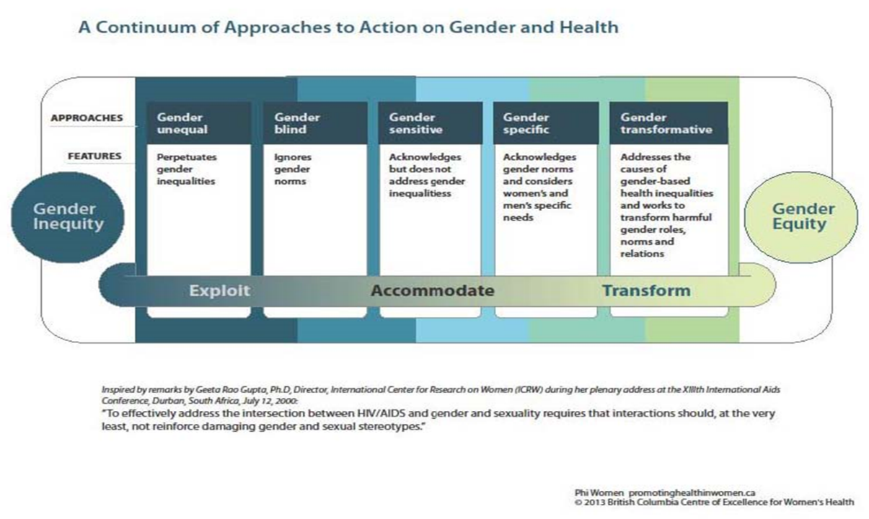
A CONTINUUM OF APPROACHES TO ACTION ON GENDER & HEALTH
Pederson, A., et al. (2015). "Gender-transformative health promotion for women: a framework for action." Health Promot Int 30(1): 140-150.

Slide 17
WHO GENDER RESPONSIVE ASSESMENT SCALE CRITERIA:
Tool for assessing programmes and policies
Level 1: Gender-unequal
Perpetuates gender inequality by reinforcing unbalanced norms, roles and relations
Privileges men over women (or vice versa)
Often leads to one sex enjoying more rights or opportunities than the other
Level 2: Gender-blind
Ignores gender norms, roles and relations
Very often reinforces gender-based discrimination
Ignores differences in opportunities and resource allocation for women and men
Often constructed based on the principle of being “fair” by treating everyone the same
Level 3: Gender-sensitive
Considers gender norms, roles and relations
Does not address inequality generated by unequal norms, roles or relations
Indicates gender awareness, although often no remedial action is developed
World Health Organization (2011). Gender mainstreaming for health managers: a practical approach. Geneva, WHO (p. 41, 42).
Notes:
Discussion:
-where would you say most of your technical assistance is at this point with TAN?
-where would you like to see TAN move towards?
Examples:
-Let’s say you have a program where you provide food to a woman so that she can increase nutrition for her children. Where would this be on the scale?
(Consider: do you understand the power structures in the household? Do you know who eats first for example in the household and who gets food if there is limited food to be had? Do you know who makes the decisions in the household on who eats what and what gets sold?)
-What if you have a program that is focused on women to encourage them to breastfeed. (Consider: the role of men, cultural norms on breastfeeding, the role of mother-in-law, who is being provided information)
-What if you are providing supplements in the classroom? (Consider: girls dropping out of school due to cultural norms, lack of access to WASH once menstruating, child marriage, or missing school due to role – e.g. collecting water)

Slide 18
WHO GENDER RESPONSIVE ASSESMENT SCALE CRITERIA:
Tool for assessing programmes and policies
Level 4: Gender-specific
Considers gender norms, roles and relations for women and men and how they affect access to and control over resources
Considers women’s and men’s specific needs
Intentionally targets and benefits a specific group of women or men to achieve certain policy or programme goals or meet certain needs
Makes it easier for women and men to fulfil duties that are ascribed to them based on their gender roles
Level 5: Gender-transformative
Considers gender norms, roles and relations for women and men and that these affect access to and control over resources
Considers women’s and men’s specific needs
Addresses the causes of gender-based health inequities
Includes ways to transform harmful gender norms, roles and relations
The objective is often to promote gender equality
Includes strategies to foster progressive changes in power relationships between women and men
World Health Organization (2011). Gender mainstreaming for health managers: a practical approach. Geneva, WHO (p. 41, 42).
Notes:
Discussion:
-where would you say most of your technical assistance is at this point with TAN?
-where would you like to see TAN move towards?
Examples:
-Let’s say you have a program where you provide food to a woman so that she can increase nutrition for her children. Where would this be on the scale?
(Consider: do you understand the power structures in the household? Do you know who eats first for example in the household and who gets food if there is limited food to be had? Do you know who makes the decisions in the household on who eats what and what gets sold?)
-What if you have a program that is focused on women to encourage them to breastfeed. (Consider: the role of men, cultural norms on breastfeeding, the role of mother-in-law, who is being provided information)
-What if you are providing supplements in the classroom? (Consider: girls dropping out of school due to cultural norms, lack of access to WASH once menstruating, child marriage, or missing school due to role – e.g. collecting water)

Slide 19
NEED TO MOVE BEYOND…
“We are doing gender because we are focused on women and girls”
“We already disaggregate data by sex”
“We have an equal number of male and female team members on the consulting team”
Notes:
Discuss: Why are these not enough to say we are mainstreaming gender?

Slide 20
GENDER MAINSTREAMING
“The process of assessing the implications for women and men of any planned action, including legislation, policies or programmes, in all areas and at all levels.
It is a strategy for making women’s as well as men’s concerns and experiences an integral dimension of the design, implementation, monitoring and evaluation of policies and programmes in all political, economic and societal spheres so that women and men benefit equally and inequality is not perpetuated”.
http://www.who.int/gender-equity-rights/understanding/gender-definition/en/

Slide 21
GENDER MAINSTREAMING (2)
Can take time as it involved changing structures in organizations, and attitudes, behaviours and practices
Requires organizational commitment, resources, champions, and skills
Involves women and men
World Health Organization (2011). Gender mainstreaming for health managers: a practical approach. Geneva, WHO. (Participant’s Notes), p. 20

Slide 22
REVIEW OF CHECKLISTS
See checklists for review and discussion
World Health Organization (2011). Gender mainstreaming for health managers: a practical approach. Geneva, WHO. (Participant’s Notes), p. 20

Slide 23
CONCLUSION
Other Critical Components Needed
Institutionalize gender into NI as an organization
Developing and implementing an organizational-wide gender strategy
Ensuring buy-in from senior management, including
  commitment of resources (including human resources)
  training on gender (including understanding why gender is critical to nutrition)
  ensuring gender is incorporated into logic models of projects (accountability)
Having gender contacts (and champions) to support this work in NI, including at the regional level

Slide 24
QUESTIONS?

Slide 25


THANK YOU
Support for this project provided by:

